Slide 1


TITLE:- BBC NEWS ARTICLE CLASSIFICATION
Madhukumar Gopal

Slide 2

ROADMAP
1.Introduction
2.Overview of Dataset
3.Model Architectures
4.Parameter Tuning
5.Evaluation Metrics
Presentation Title

Slide 3

INTRODUCTION TO DATASET
Dataset Summary:
Total Records: 2,225 articles.
Categories: 5 distinct categories:
Business
Entertainment
Politics
Sport
Tech
Average Text Length: Approximately 2,264 characters per article.

Slide 4
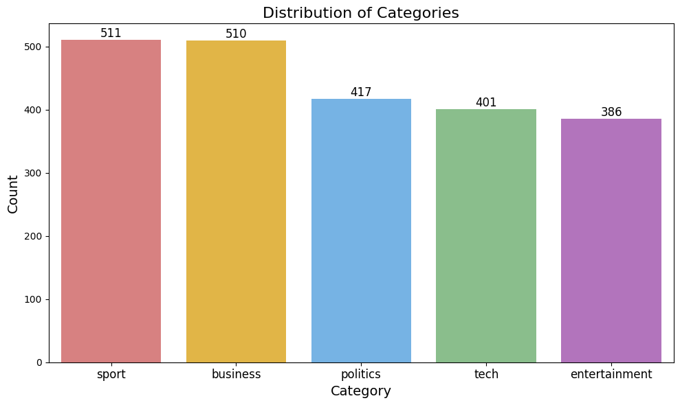
Visualizations

Slide 5
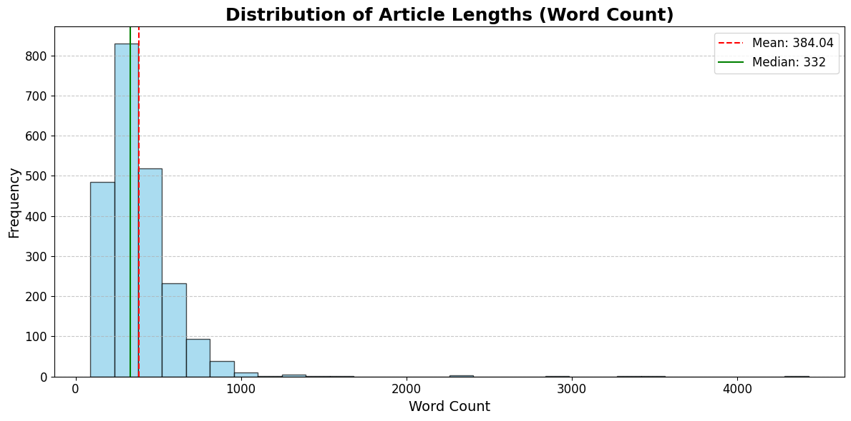
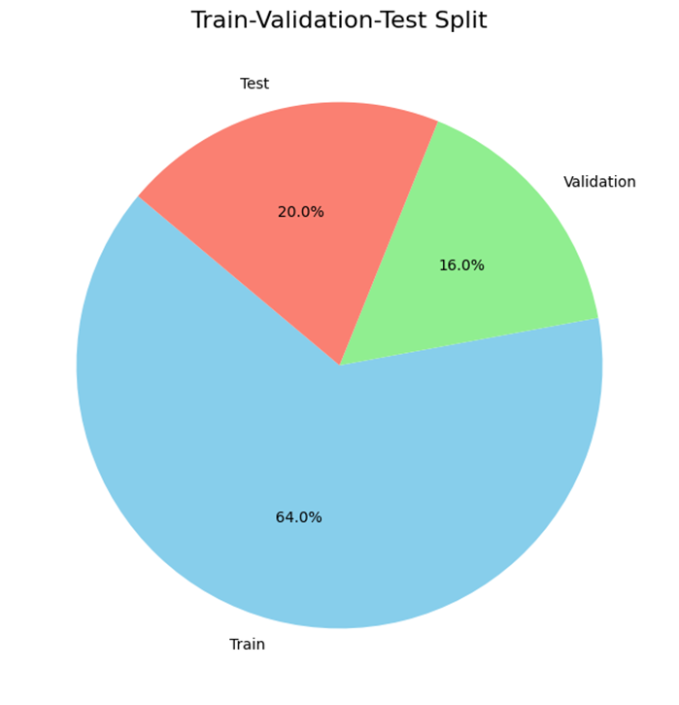
The highest frequency of articles has a word count in the range of approximately 200–400 words.
The mean word count is approximately 384 words, as indicated by the red dashed line

Slide 6


Slide 7
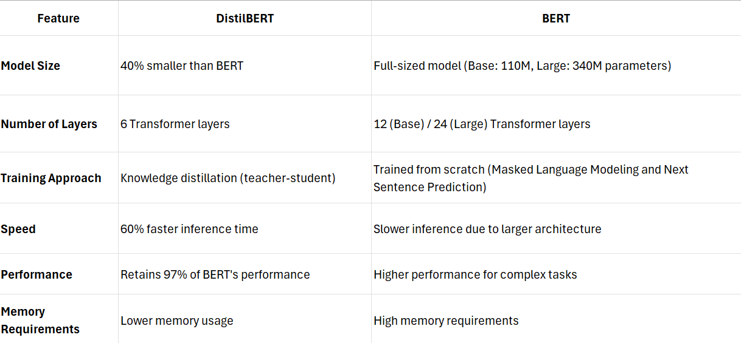
1.DISTILBERT
Why DistilBERT?:
Faster and smaller than BERT.
Retains 97% of BERT’s performance but with a 40% reduction in size

Slide 8
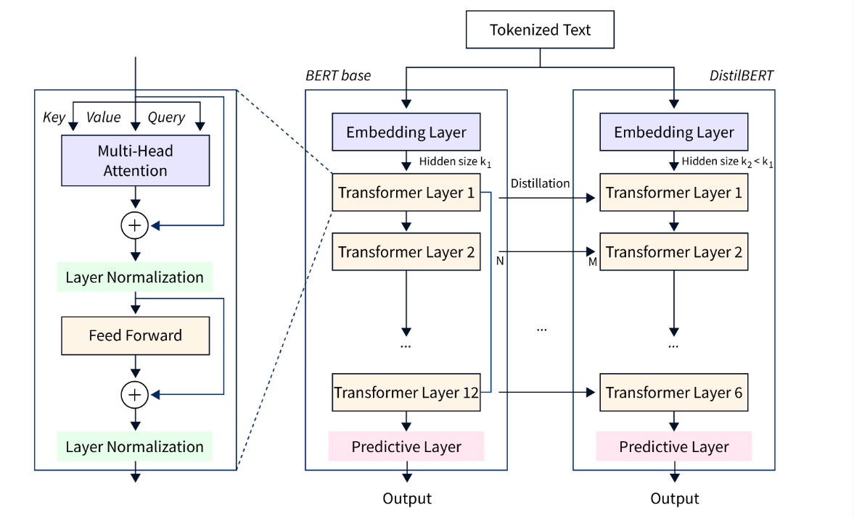
ARCHITECTURE

Slide 9
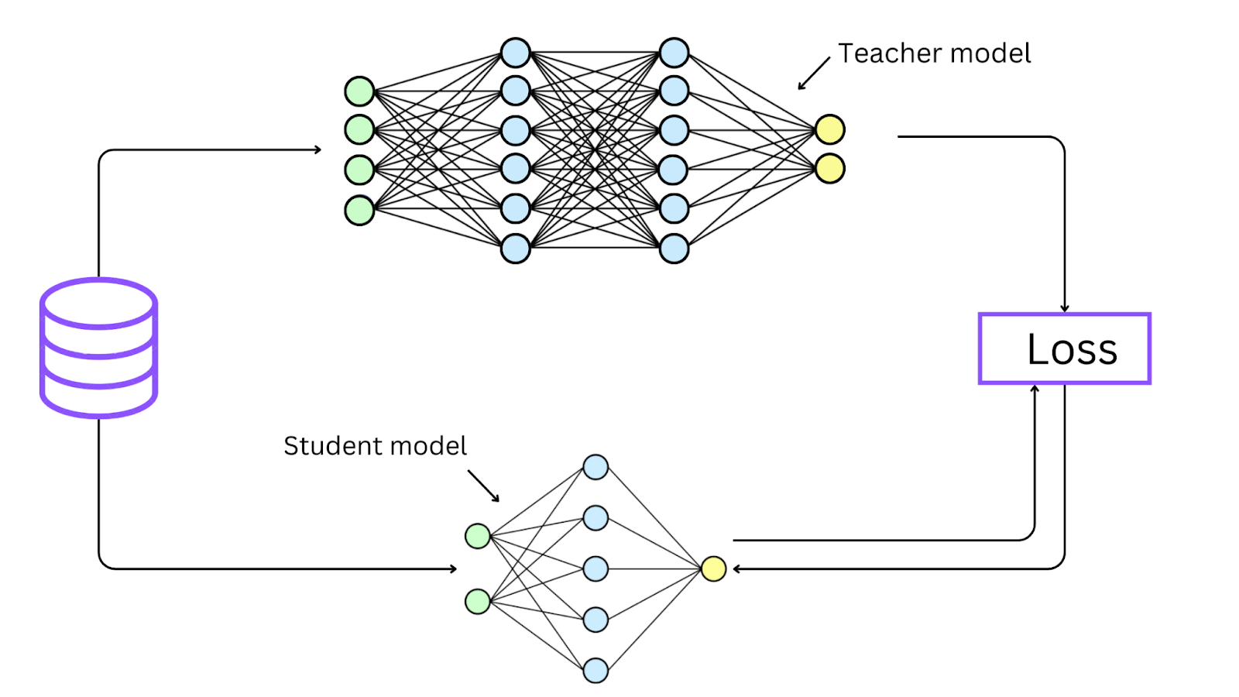
Uses knowledge distillation:
Mimics the output of BERT through teacher-student training.
Focuses on Masked Language Modeling (MLM), removing the Next Sentence Prediction (NSP) task for simplicity.

Slide 10
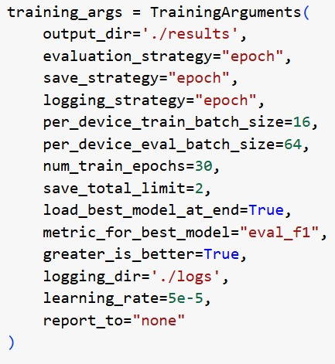
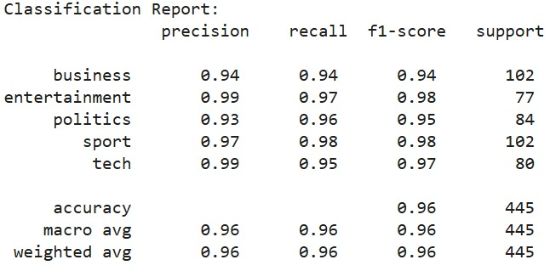
PARAMETERS
EVALUATION

Slide 11
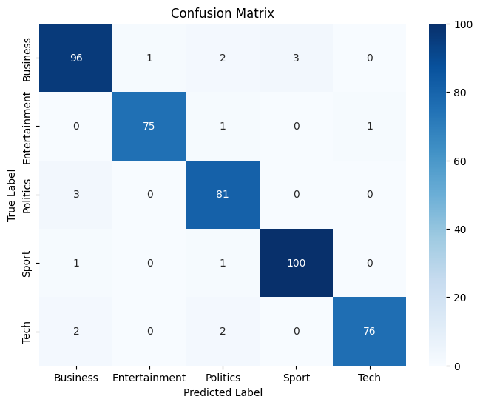
The diagonal entries (correct classifications) dominate, indicating excellent classification performance

Slide 12
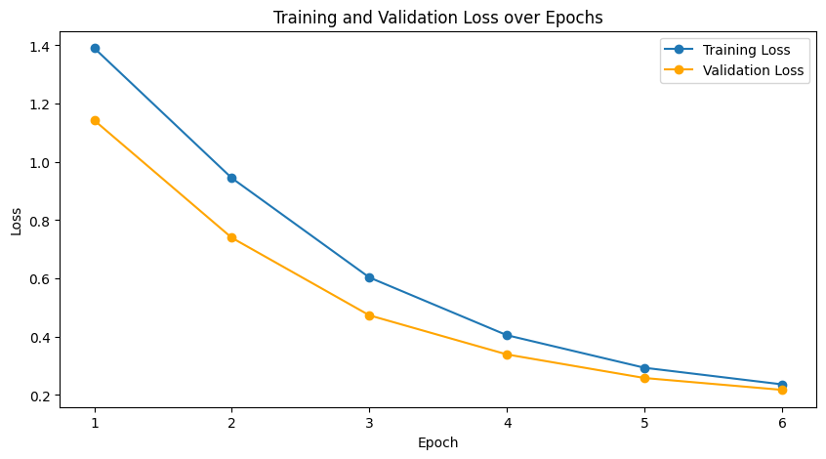
Around epoch 5-6, the losses stabilize, indicating that the model has nearly converged and further training might not significantly improve performance

Slide 13
2.ALBERT
Parameter Efficiency: ALBERT uses 89% fewer parameters than BERT by employing cross-layer parameter sharing and factorized embeddings, making it faster and lighter.
Improved Sentence Understanding: Replaces BERT's Next Sentence Prediction (NSP) with Sentence Order Prediction (SOP) for better inter-sentence coherence.
Same Layers, Smaller Model: ALBERT has the same number of layers as BERT but achieves compactness through parameter sharing across layers.
High Accuracy: Retains 95-98% of BERT's accuracy while significantly reducing memory usage and training time.

Slide 14
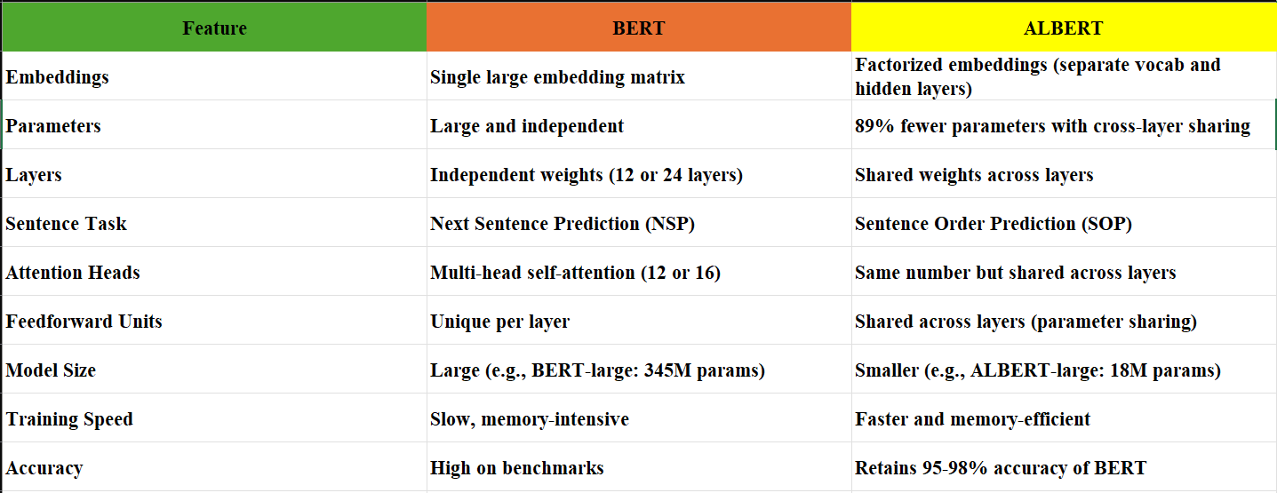
BERT VS ALBERT

Slide 15
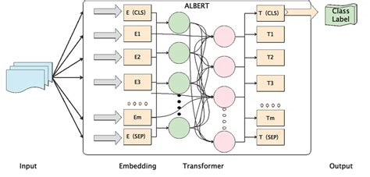
ARCHITECHTURE
E (CLS) vs. T (CLS):
E (CLS): Input token embedding representing the start of the sequence.
T (CLS): Output embedding summarizing the sequence for classification tasks.
E (SEP) vs. T (SEP):
E (SEP): Input token embedding marking the separation between sentences.
T (SEP): Output embedding capturing contextual separation between sentences.
E1, E2... vs. T1, T2...:
E1, E2...: Input word embeddings for individual tokens.
T1, T2...: Contextualized token embeddings after passing through Transformer layers.

Slide 16
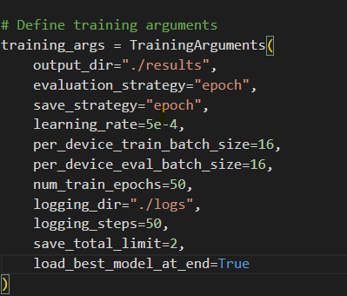
PARAMETERS
Learning Rate (0.0005 ): Optimized for faster convergence with only the classification head trainable, ensuring efficiency.
Evaluation & Saving Strategy: Model is evaluated and checkpoints saved at each epoch to track progress and prevent overfitting.
Batch Size (16): Balanced for GPU memory efficiency and stable updates during training and evaluation.
Epochs (50) with Early Stopping: Allows sufficient learning time while early stopping prevents overfitting.
Best Model Loading: Automatically retrieves the best-performing model, ensuring optimal evaluation performance.

Slide 17
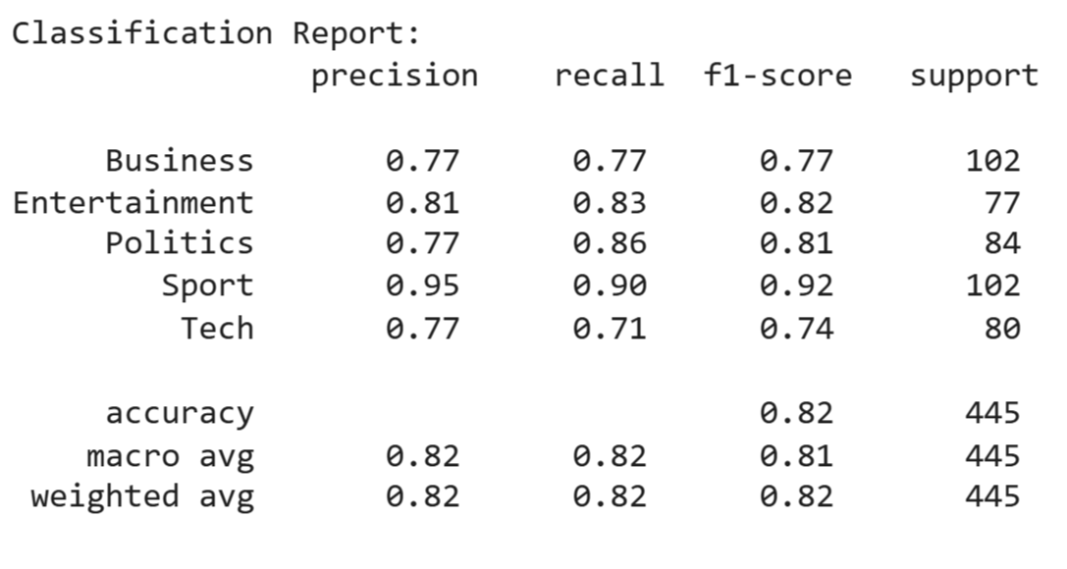
EVALUATION
High F1 for Sport (0.92): Sports articles have distinct language and context, making them easier for the model to classify accurately.
Low F1 for Tech (0.74): Tech articles often overlap with business or entertainment topics, leading to higher misclassification.

Slide 18
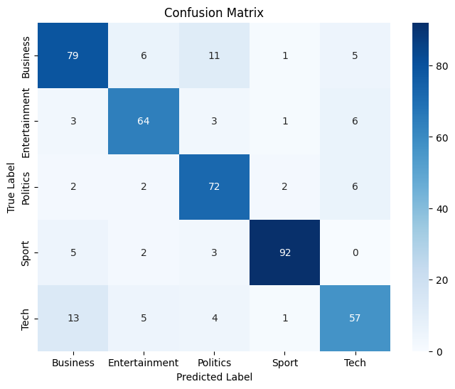
Business vs. Politics: Misclassification due to overlapping topics like economic policies.
Tech vs. Business: Confusion caused by articles on technology companies.
Entertainment vs. Tech: Ambiguity arises from media-tech innovations.

Slide 19
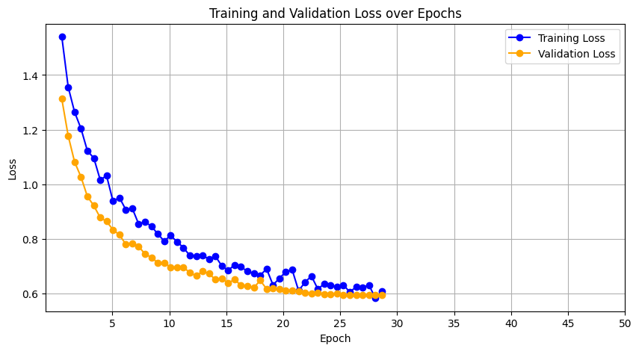
Early Stopping at Epoch 25: Training stopped because validation loss stopped improving, preventing overfitting and saving time.

Slide 20
3.RNN WITH FFN CLASSIFIER HEAD
Sequential Processing: RNNs excel at handling data with sequential dependencies, such as sentences or paragraphs.
Hidden State: The internal memory of the RNN that allows it to retain context across steps in a sequence.
FFN Head: The classification head that applies weights to the RNN's output and predicts the final class label.
Custom Design: Combining an RNN with an FFN allows flexibility in tuning for specific tasks, such as classifying articles into distinct categories.

Slide 21
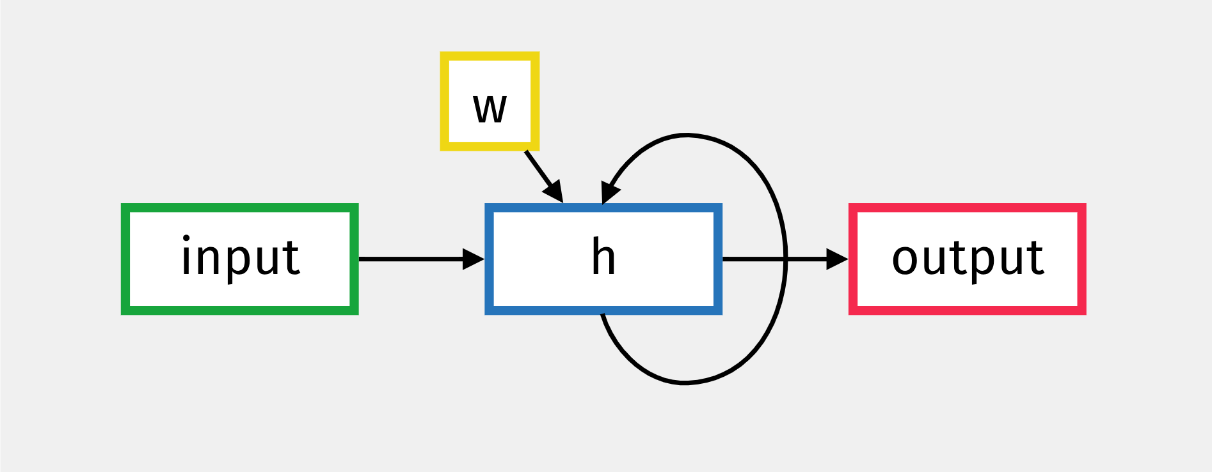
ARCHITECHTURE
Input (Green): Sequential data (e.g., words) fed at each time step.
Hidden State (Blue - h): Memory unit retaining and updating past information.
Weights (Yellow - w): Parameters influencing hidden state updates and output.
Output (Red): Generated context-aware result at each time step.
Recurrent Loop (Arrow): Feedback mechanism for sequential dependency learning.

Slide 22
PRE-PROCESSING
Special Characters Removal: Eliminated symbols and extra spaces for clean text input.
Numeric Normalization: Standardized numbers (e.g., "5M" → "5 million").
Financial Unit Conversion: Converted financial terms into consistent formats.
Custom Preprocessing: Tailored cleaning steps optimized for the RNN model to ensure effective sequential learning.
EMBEDDING DETAILS
Embedding Details:Word2Vec pretrained embeddings with 300 dimensions. Vocabulary Statistics: Vocabulary
Size: 32437. Embedding Matrix Shape: (32437, 300).

Slide 23
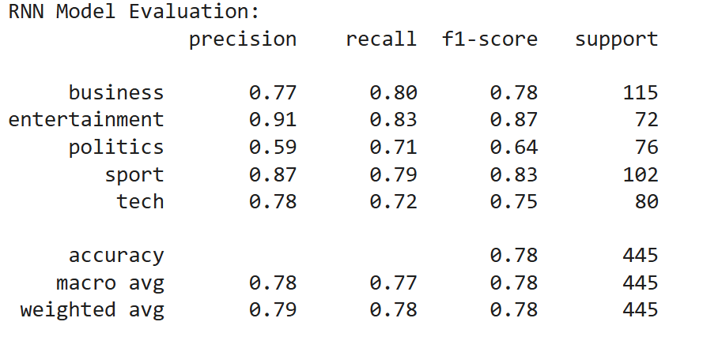
SIMPLE RNN EVALUATION
The Simple RNN performs well in clear categories like “Entertainment” and “Sport”.
It handles complex categories like “Politics” and “Tech” moderately due to overlapping themes.
The model is simple, efficient, and achieves “78% accuracy”.

Slide 24
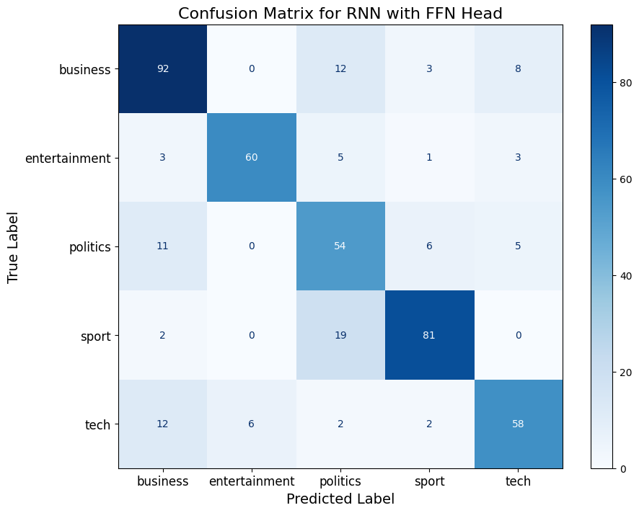
Best Performing (Sport): Clear and distinct language resulted in accurate classification.
Politics Misclassification: Confused with Business due to overlapping trends in economic discussions and governance topics.
Tech Misclassification: Misclassified as Business because of shared themes in technology industries and market innovations.

Slide 25
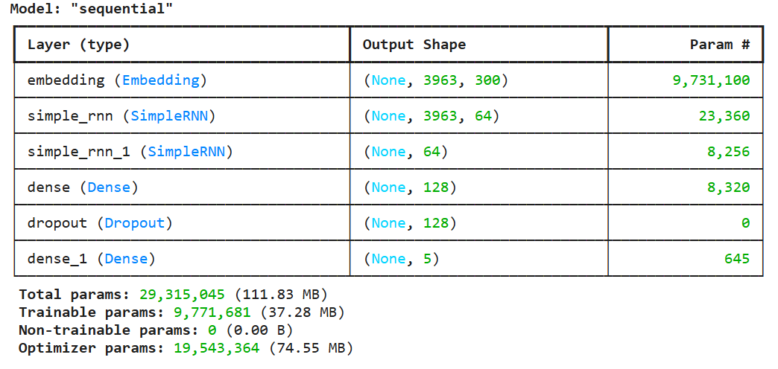
SIMPLE RNN MODEL SUMMARY
Embedding Layer: Converts input words into dense vectors of size 300.
RNN Layers: Two layers (Simple RNN) that process sequence patterns with 64 units each.
Dense & Dropout Layers: Layers with 128 units for classification and dropout to prevent overfitting.
Output Layer: Predicts 5 categories based on the input.

Slide 26
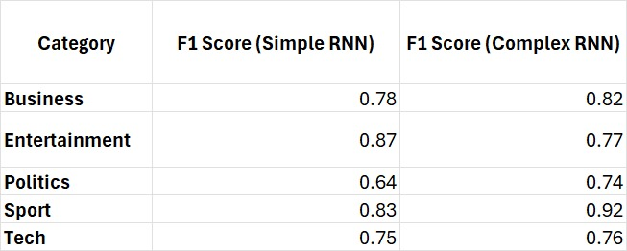
SIMPLE RNN VS COMPLEX RNN
Context: Simple RNN reads data one way, while Bidirectional RNN learns from both past and future, boosting performance for sequences like Politics and Sport.
Efficiency: Simple RNN is faster and lighter, while Bidirectional RNN improves accuracy with more computation

Slide 27
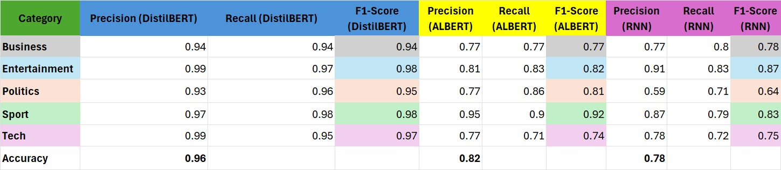
PERFORMANCE COMPARISON OF TEXT CLASSIFICATION MODELS (DISTILBERT, ALBERT, RNN)

Slide 28
Why ALBERT Underperformed?
1.Data Size Sensitivity: ALBERT, designed for large datasets, couldn’t fully leverage its advanced mechanisms like SOP and weight sharing on the small dataset of 2,225 samples.
2. Reduced Parameters: ALBERT’s parameter-sharing design sacrifices some representation power, making it less effective in capturing task-specific nuances in small datasets.
Why RNN Underperformed:
1. Limited Contextual Learning: RNNs struggle with long-range dependencies and complex relationships, which DistilBERT and ALBERT handle better with Transformers.
2. Lack of Pretraining: Unlike DistilBERT and ALBERT, RNN lacks pretrained contextual knowledge, relying only on task-specific learning, which is less effective for diverse categories.
Why DistilBERT Excelled:
1. Efficient Pretraining: DistilBERT’s knowledge distillation from BERT enables it to retain strong contextual understanding with fewer parameters, making it highly effective even on small datasets.
2. Simpler Architecture: Its lightweight design and focus on core contextual learning allow it to generalize better across all categories in the dataset.

Slide 29

CHALLANGES
Challenges Faced:
ALBERT:
Layer Freezing: Fine-tuning only the classification layer limited performance; unfreezing layers improved learning.
Small Dataset: ALBERT struggled to leverage its advanced mechanisms on the 2,225-sample dataset.
RNN (Word2Vec):
Static Embeddings: Word2Vec lacked context, limiting nuanced feature capture.
Sequential Limits: RNN struggled with long dependencies and contextual richness.
DistilBERT:
Pretraining: Distilled knowledge from BERT ensured strong small-data performance.
Simplicity: Lightweight architecture enabled better generalization and tuning.
Major challange: Hyperparameter tuning through trial and error was critical to optimizing performance of Albert

Slide 30


Slide 31

THANK YOU

